Slide 1



MTA Post-Pandemic Mobility Recovery
Project Team
Amr Mohammed Ahmed Mohammed Mohamed Mamdouh Fathy Bishoy Mina El Malah Paula Sameh Sobhy Abanoub Shawket Ragheb

Slide 2






Project Objectives
Quantify Recovery
Analyze Modal Shift
Identify Hybrid Work
Calculate the exact recovery percentage for 2024/2025 compared to Pre-Pandemic baselines across all agencies (Subway, Bus, LIRR, Bridges).
Compare the recovery trajectory of Mass Transit vs. Private Vehicles to identify permanent shifts in commuter preference.
Analyze Day-of-Week trends to validate the "Tuesday-Thursday Peak" and measuring the drop-off on Mondays and Fridays.

Slide 3





3-Tier System Architecture
Layer 1: ETL
Layer 2: Warehouse
Layer 3: BI
Python (Pandas) Normalization of "Wide" data, cleaning.
SQL Server Schema enforcement, centralized business logic (Views), and temporal enrichment.
Power BI Interactive visualization, DAX-free KPI tracking, and dynamic filtering.

Slide 4
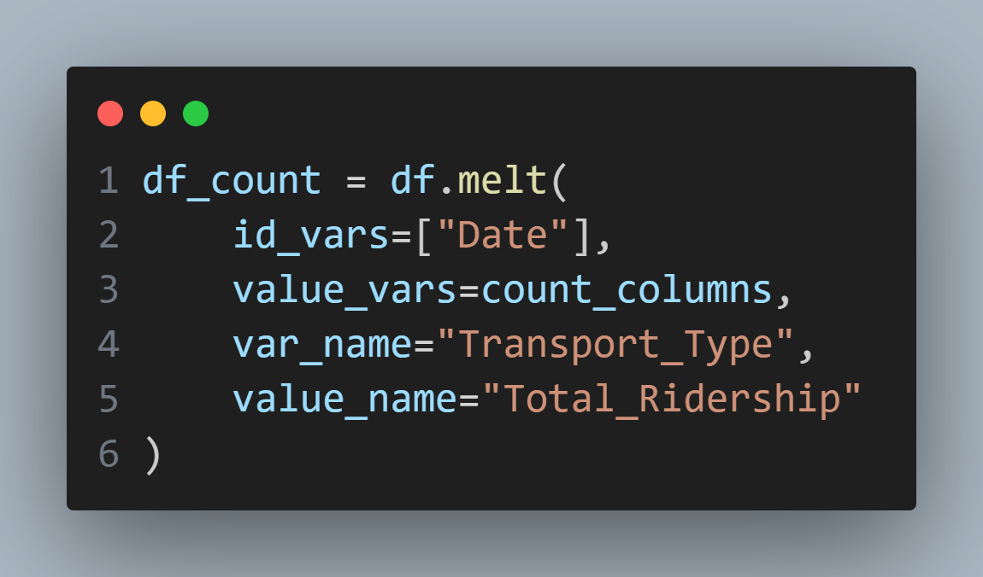
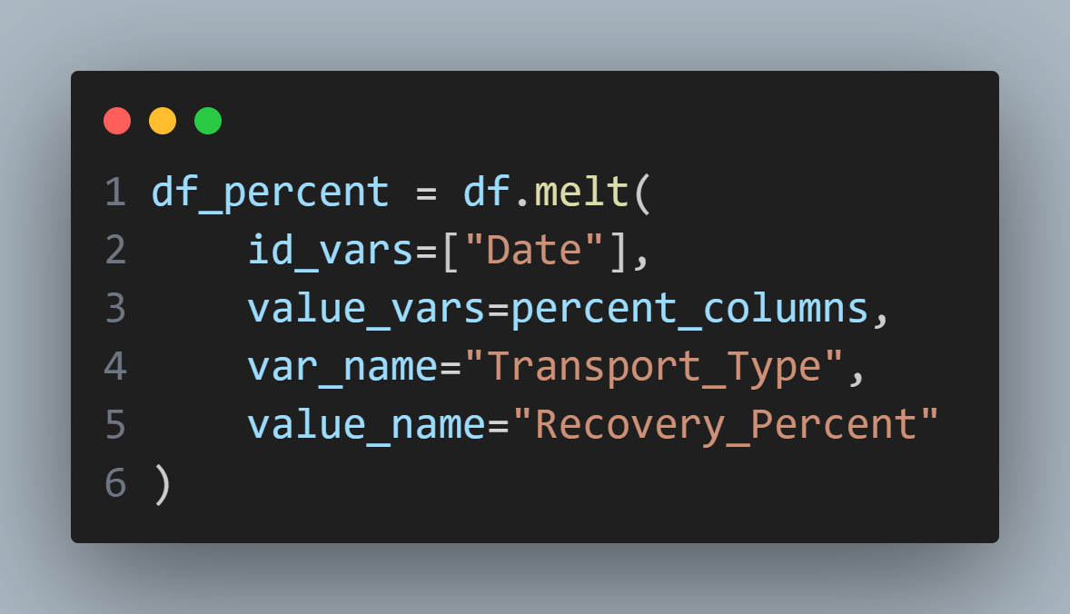
Phase 1: Algorithmic Data Cleaning
The "Wide Data" Problem
The raw MTA data contained 15 separate columns for different transport modes, making time-series analysis impossible.
The Solution:
•
Developed a Python script using pandas.
•
Implemented a Melting Algorithm to unpivot data into a relational structure.

Slide 5
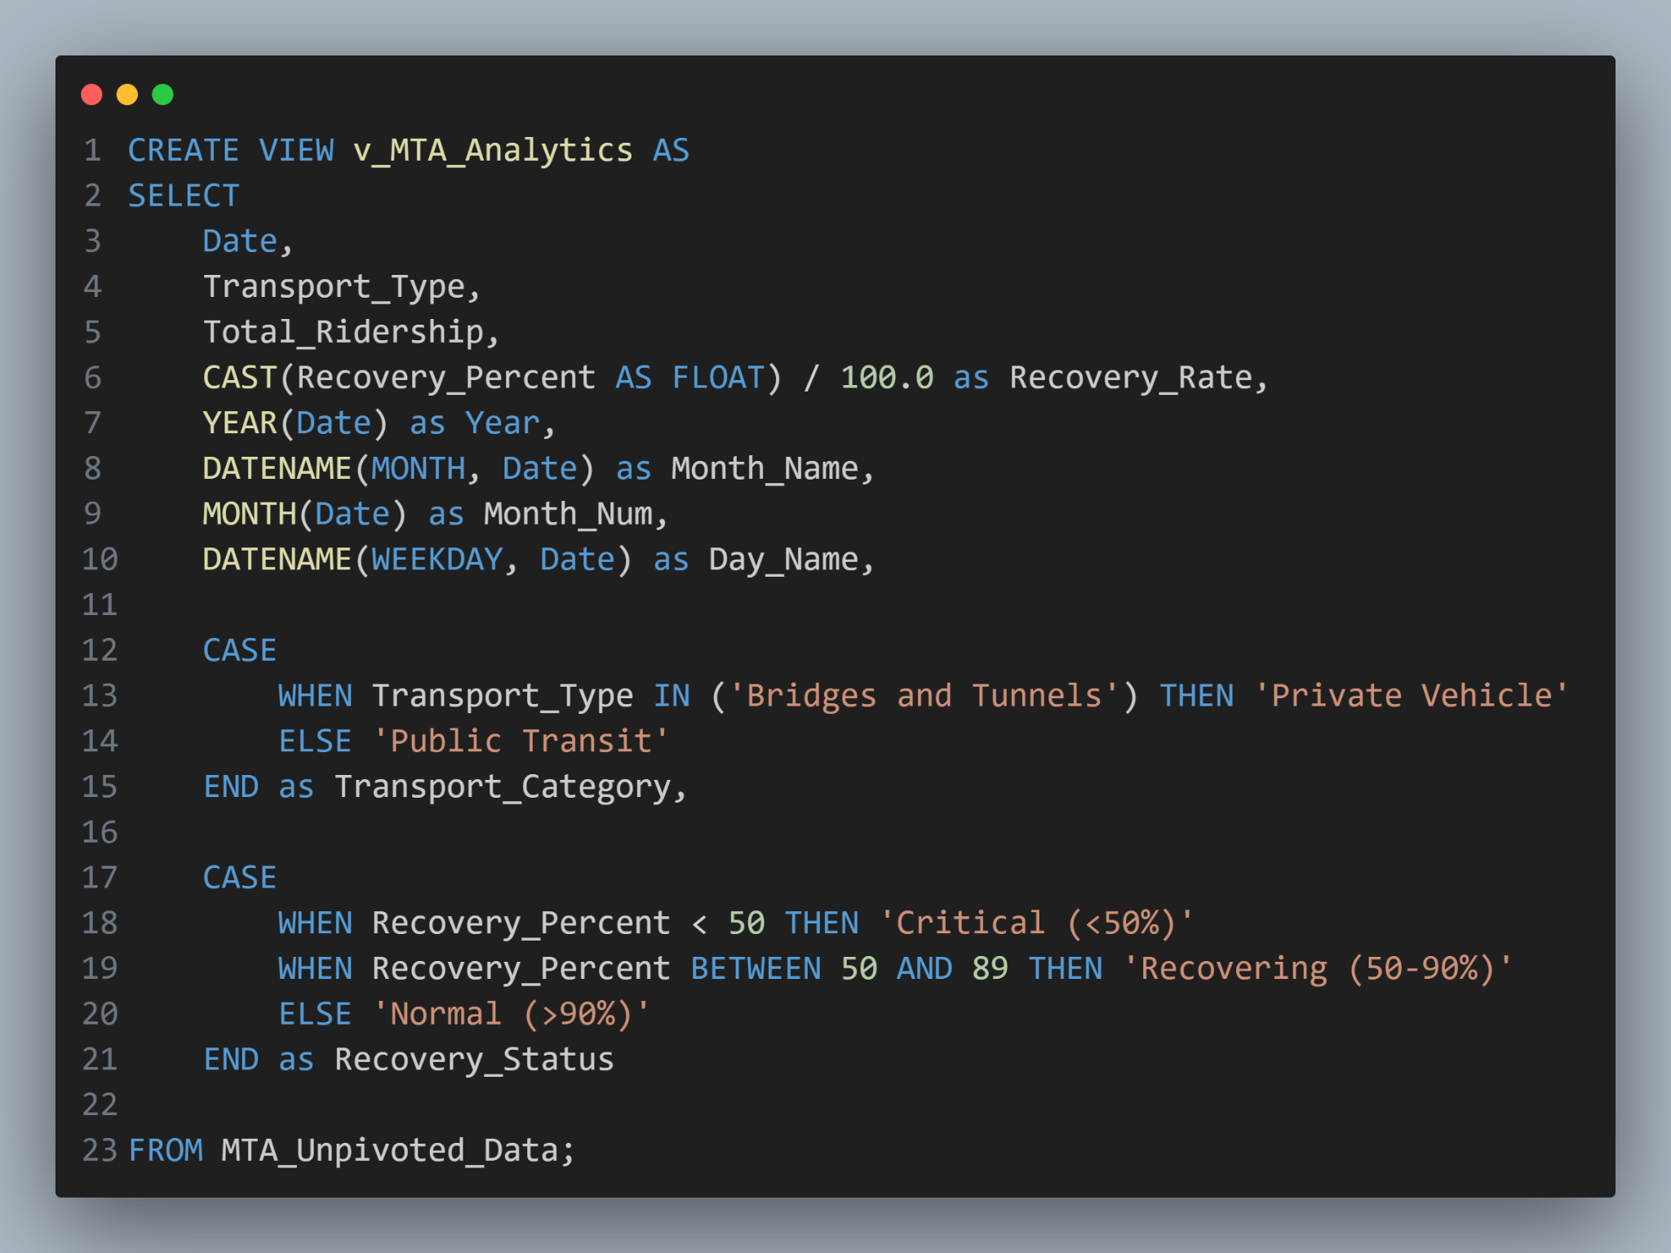


Phase 2: SQL Logic Centralization
Enrichment & Business Logic
We adhered to the "Push-Down" optimization principle, moving logic from the BI tool to the Database layer.
Key SQL Transformations:
•
Time Intelligence: Extracted Day_Name to detect weekend patterns.
•
Categorization: Grouped agencies into "Public" vs. "Private".
•
Recovery Status: CASE statements to classify days as "Critical", "Recovering", or "Normal".

Slide 6


Dashboard: Executive Summary

Slide 7
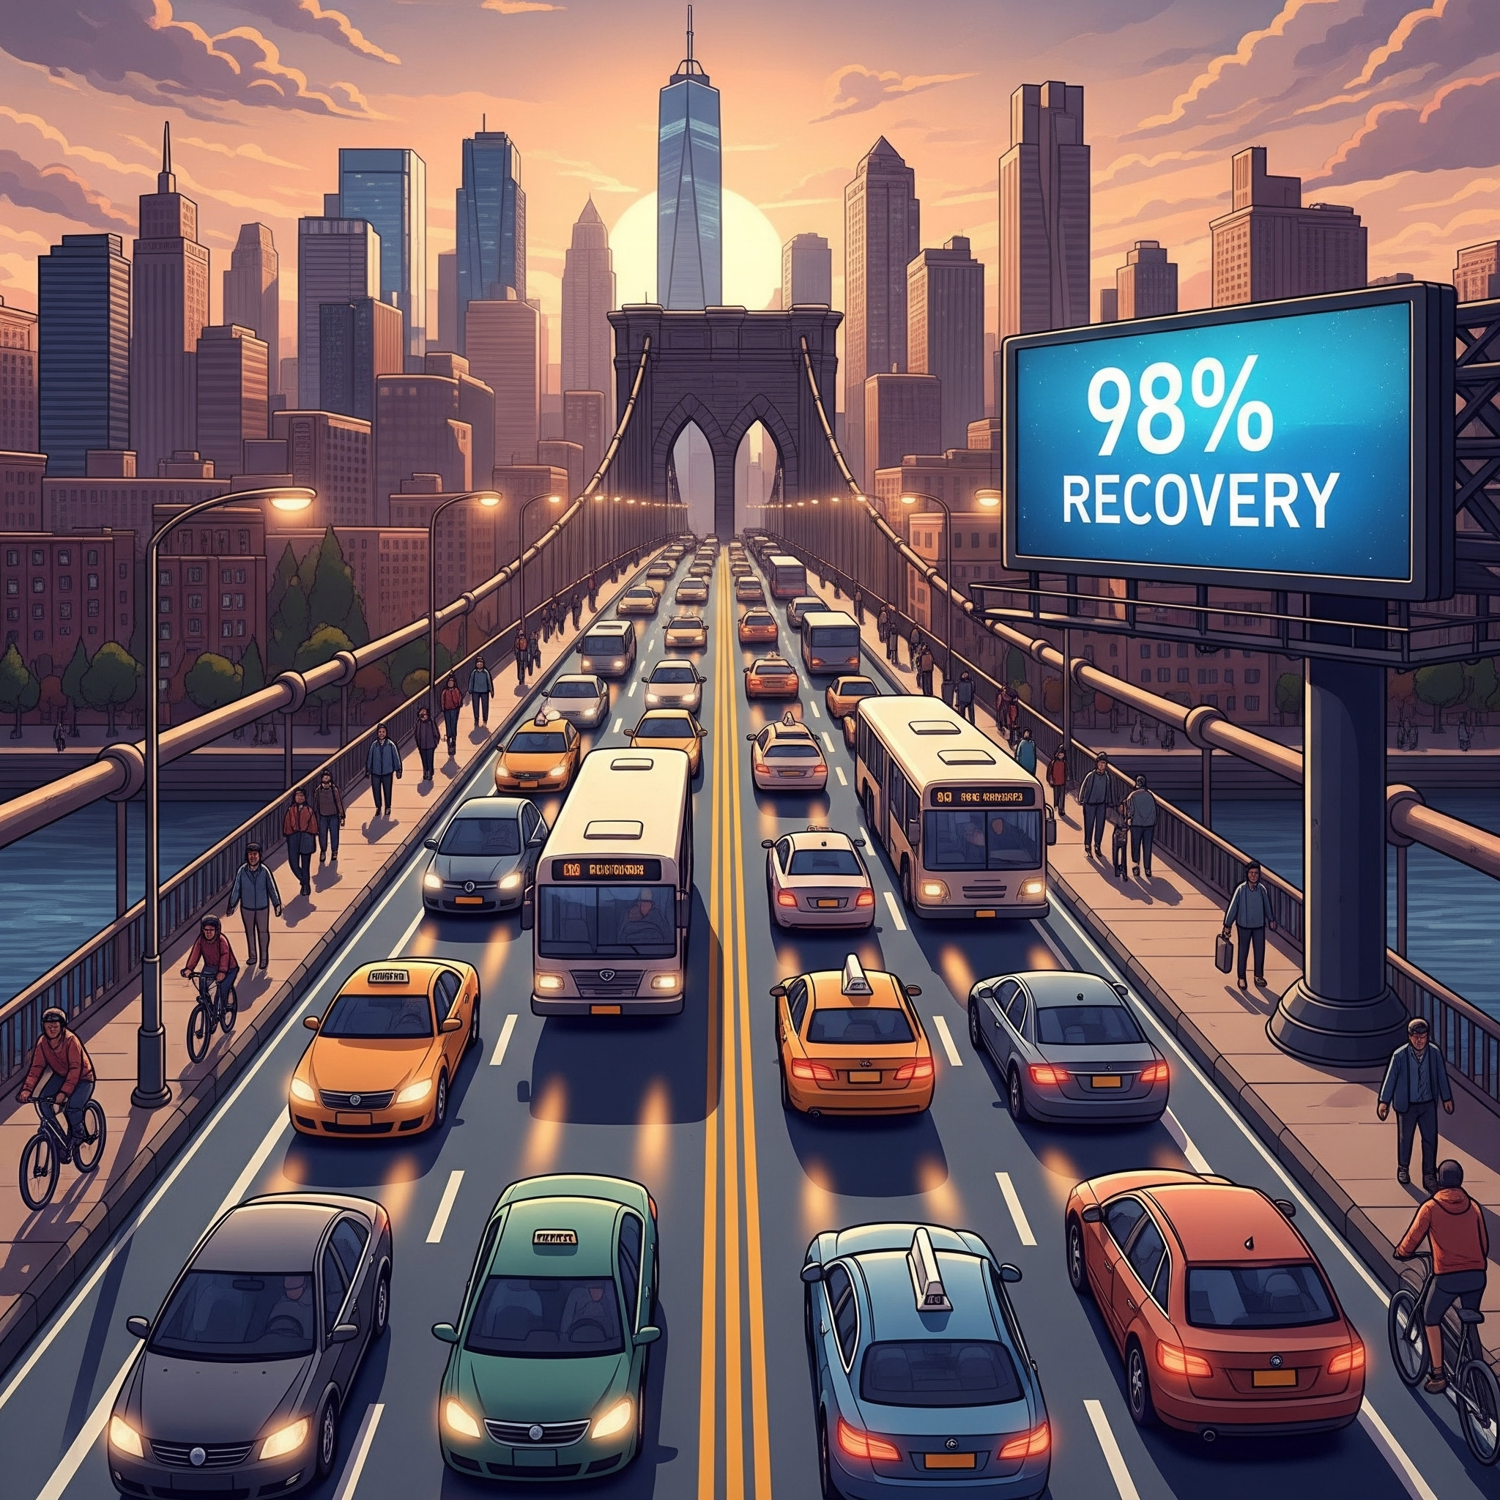
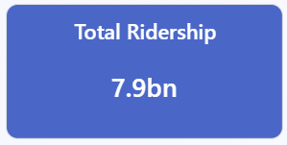
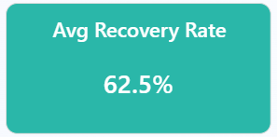
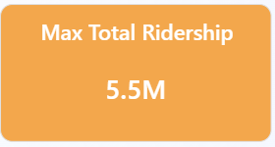
KPI Scorecards

Slide 8
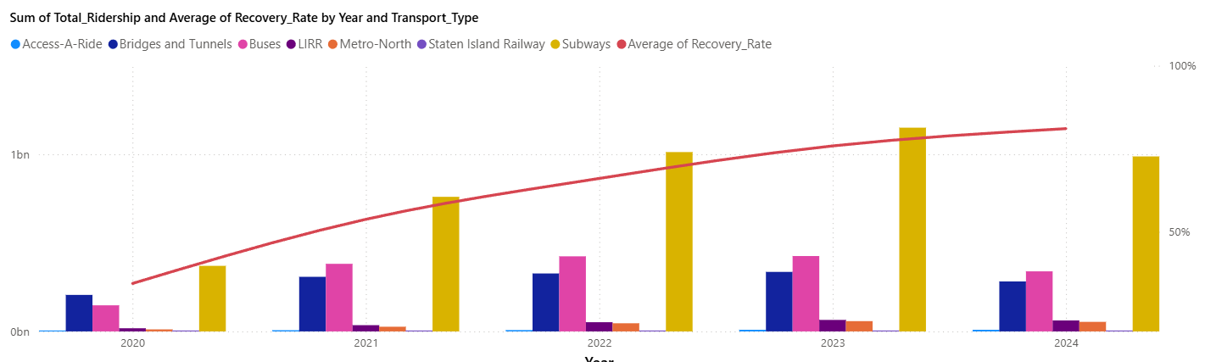
Analysis: General

Slide 9
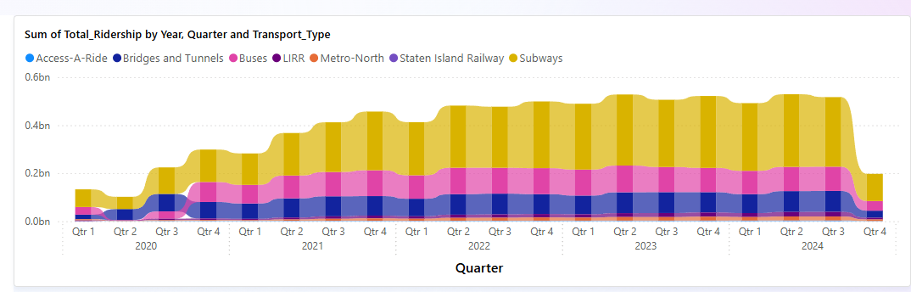
Analysis: Quarterly Ridership Analysis

Slide 10
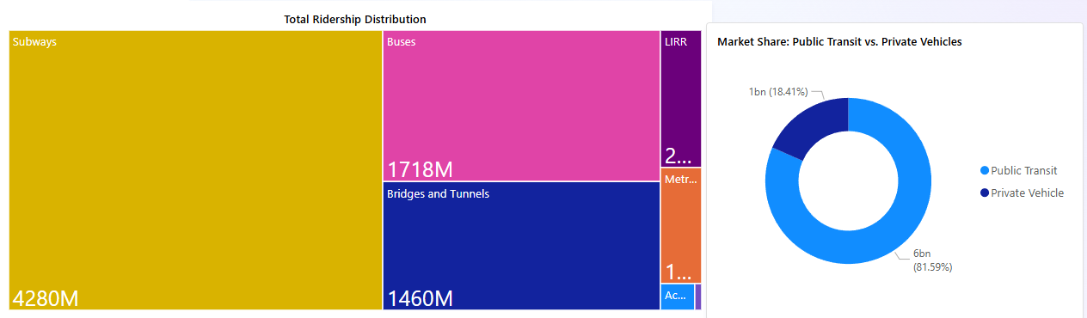
Analysis: Quarterly Ridership Analysis

Slide 11
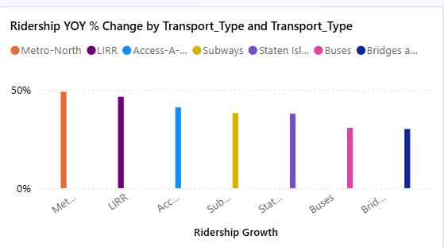
Innovation: YoY Growth Analysis

Slide 12
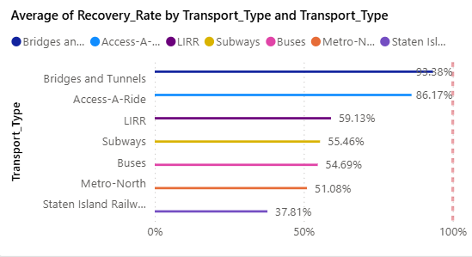
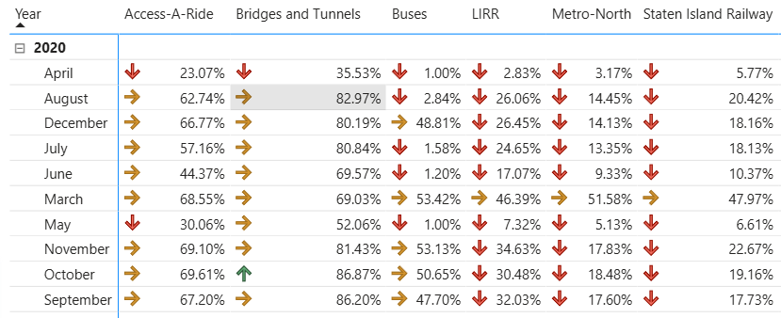
Innovation: Recovery Analysis

Slide 13
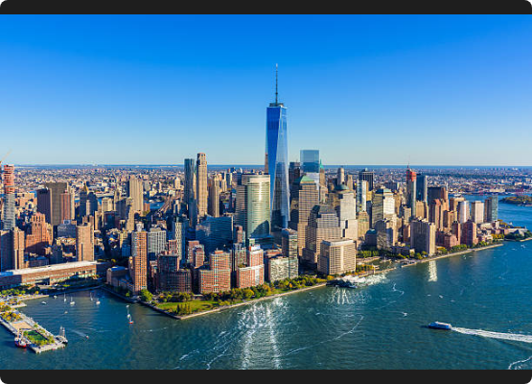
Conclusions & Recommendations
Key Findings
Recovery is stabilizing but has not reached 2019 levels for public transit.
Recommendations
If the subway doesn't recover, the MTA doesn't recover. Spend your money on making subways cleaner, safer, and faster to get those people back.

Slide 14



Q&A
Thank you for your attention.
Python
SQL Server
Power BI

